Slide 1
Social Studies
Unit 1: Our Colonial Heritage
Chapter 1: The World Before the Opening of the Atlantic
Essential Question: How did American, African, and European cultures differ from another before 1500 ?

Slide 2
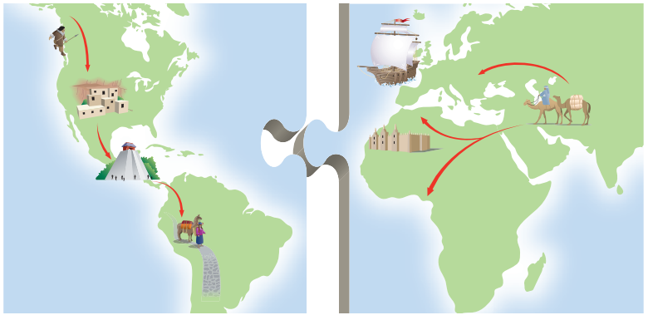
Reading Social Studies
Themes of this Chapter: Economics and Geography
Journal/Discussion Question:
What role did economics and geography play in the settlement and exploration of the Americas?

Slide 3
Specialized Vocabulary: Time
Decade
BCE
BC
AD
CE
Era
Century
a period of 10 years _________________
a period of 100 years ________________
a long period marked by great events, developments, or figures_________________
a term used to identify dates that occurred long ago, before the birth of Jesus Christ, the father of Christianity. _________________________
another way to refer to BC dates; it stands for "before the common era" _______________
another way to refer to AD dates; it stands for "common era" ________________
a term used to identify dates that occured after Jesus' birth; it comes from the Latin phrase " the year of the Lord."_______________

Slide 4
Specialized Vocabulary :
Government and Society
movement
economics
colony
politics
campaign
the art of creating government policies _____________
the study of the creation and use of goods and services
______________________
a series of actions that bring about or try to bring about a change in society ________________
an effort to win a political office, or a series of military actions ___________________
a territory settled and controlled by a country ________

Slide 5
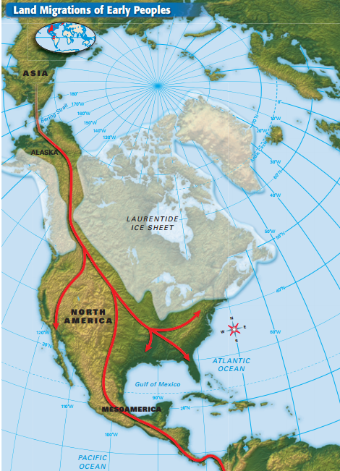
Section 1: The Earliest Americans
Main Ideas:
1.) Climate change allowed Paleo-Indians to begin the first migration to the Americas.
2.) Early societies existed in Mesoamerica and South America.
Notes:
- Scientists believe that the migration occurred during the last Ice Age 38,000- 10,000 BC.
- Migration was possible b/c ocean levels dropped when glaciers formed revealing land
-Paleo-Indians migrated south to Canada, the U.S and South America over thousands of years following food sources ( hunter-gatherers)
- Climate Change in 8,000 BC ended the Ice Age
- Warm Climate builds permanent settlements b/c animal herds and plants
-Cultures begin to develop Native American societies that adapted to the environment and changed over time.
-Agriculture begins to expand allowing people to stay in one place.
Unit1_MapActivity.pdf

Slide 6
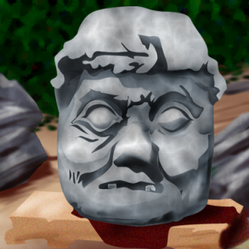
Early Mesoamerican and
South American Societies

Slide 7
Homework:
online quiz 1.1
pg.9 #1&2 in homework section

Slide 8
Section 2: Native American Cultures
Main Ideas:
1.) Several early socieites developed in North America long before Europeans explored the continent.
2.) Geographic areas influenced Native American cultures.
3.) Native American cultures shared beliefs about religion and land ownership.

Slide 9
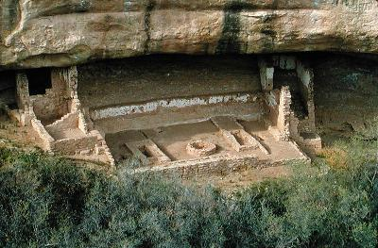
Early Societies
Anasazi
-1500 BC
-lived in the Four Corners Region where Arizona, Colorado, New Mexico, and Utah meet.
- adapted to dry environment by growing maize,beans, and squash using early irrigation techniques
-made baskets, pots, and built underground ceremonial chambers called kivas.
-lived in clay houses called pueblos and cliff dwellings

Slide 10
Mound Builders
- The Hopewell people were a farming society in the Mississippi, Ohio, and lower Missouri river valleys
-Built large burial mounds to bury dead
-Mississippians took over the same area by 700 AD and had large cities
-Also built mounds for religious purposes

Slide 11
Native American Cultures
North and Northwest
Inuit and Aleut (Artic)
-Alaska and Canada
- both had the same
language and fished
and hunted to survive
Subartic Societies
-Dogrib and Montagnais
-some followed seasonal
migrations, others lived
in villages.
Pacific Northwest
-made totems
-believed in social
importance
West and Southwest
- lived and traveled in family groups
-some groups were the Hupa, Miwok, and Yokuts
-more than 100 languages
- Pacific coast of present day US and as far east as Nevada
- adapted to dry climate by planting beans, maize,
-Some Pueblo groups were the Hopi and Zuni
-Some Apache and Najavo lived in this region too.

Slide 12
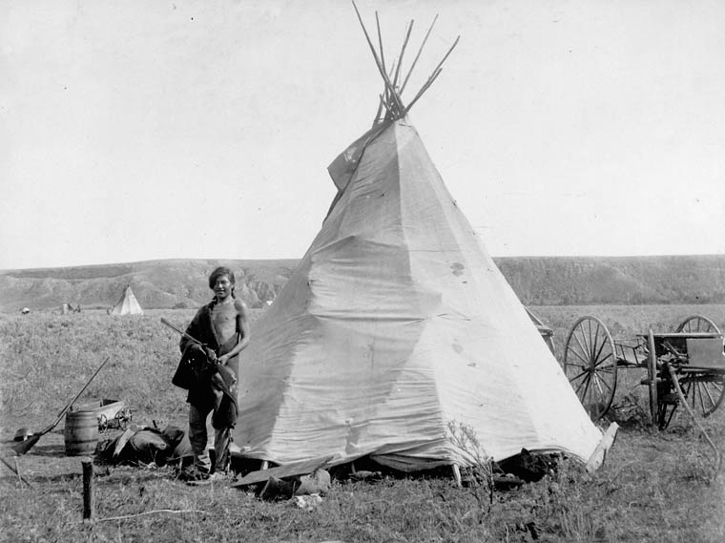
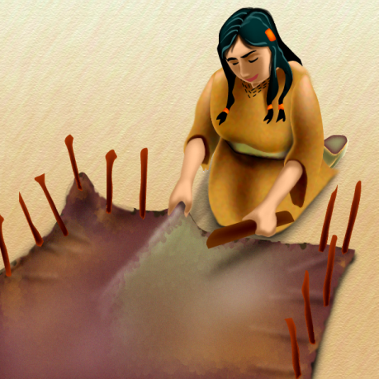
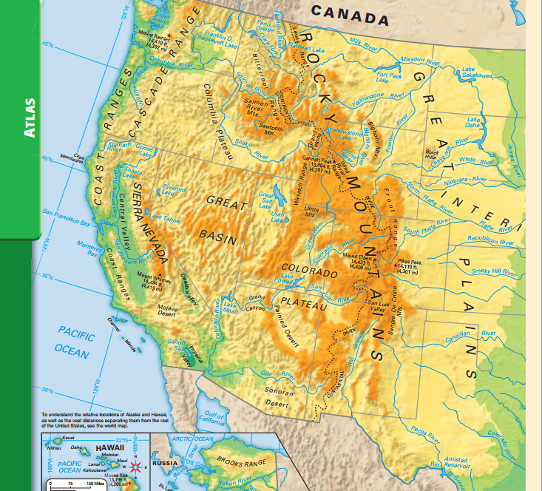
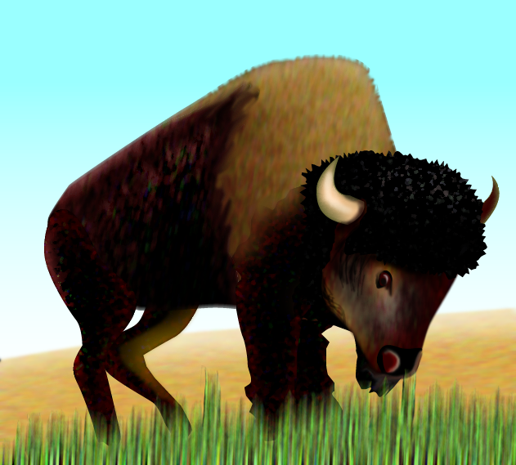
The Great Plains
Most built shelters
in homemade teepees
that were covered in
hides from animals they
hunted.
Nomadic Hunters
Some Plains people like the Mandan and Pawnee settled in villiages, lived in lodges, and farmed to survive.
- Grew beans and squash, and corn
- Followed a matrilineal society based on their mother's lineage.

Slide 13
Northeast and Southeast
The region was rich in resources
What are the benefits of having these resources ?
Southeast - Cherokee, Creek, Seminole who lived in farming villages governed by councils.
Northeast- Algonquin -hunted,gathered, fished, and bartered homemade goods .
East- Iroquois - traders who lived in longhouses
Created the Iroquois League, an alliance that fought with and worked with other tribes to prevent invasion.

Slide 14
Beliefs
Nature -spiritual forces
were everywhere in all
parts of the Earth. Animals
and plants were spirits that
Native American cultures
honored.
Many preformed ceremonies and prayed to their protectors
Property- an individuals property
only applied to one's crops.
Other land was for everyone
to enjoy. Land was special and
should be preserved for future
generations.
Not politically driven. Cultures were not interested in starting empires or big units.

Slide 15
Group Activity - p 15. #4 Comparing and Contrasting
In groups create a graphic organizer like the one on page 15 in your notebooks. You will be asked to share your groups' findings with the class.
Homework
Section 2 Assessment p 15
1-3

Slide 16
North/Northwest
West and Southwest
Northeast and Southeast
Great Plains

Slide 17
Attachments
Unit1_MapActivity.pdf

