Slide 1
Essential Question:
How did imperial competition between Britain & France lead to the French & Indian War?

Slide 2
Class Activity
North America 1754
Use the map provided to identify the extent of the Spanish, French, & British colonial control in North America by 1750

Slide 3
Key Preview Questions
North America 1754
Which nation on the map had the “best” colonies? Why?
Based on the map, what problems might arise among the European powers?
How should these nations work out their differences?

Slide 4
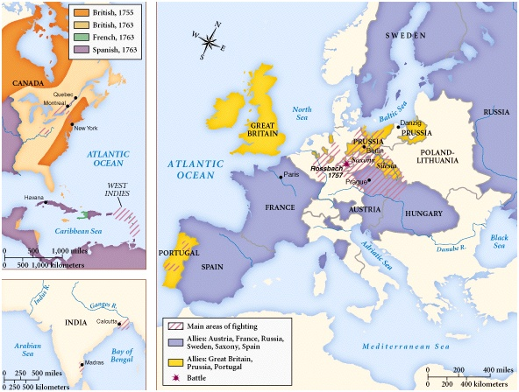
By 1750, Britain & France had become serious rivals because:
Both nations used mercantilism to expand their colonial claims in order to increase their wealth
Britain & France went to war 3 times in Europe from 1690-1750
These wars in Europe meant that their colonists would fight too
Notes:
Both nations used mercantilism to expand their colonial claims in order to increase their wealth

Slide 5
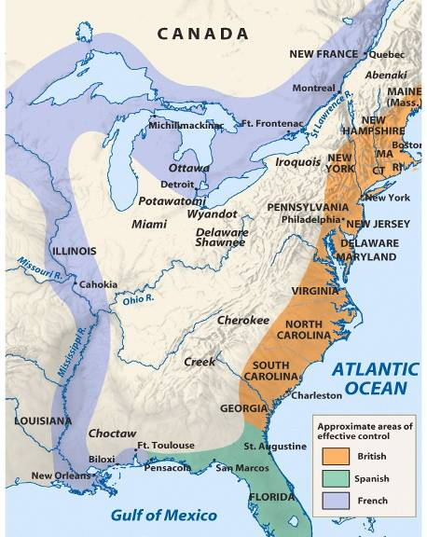
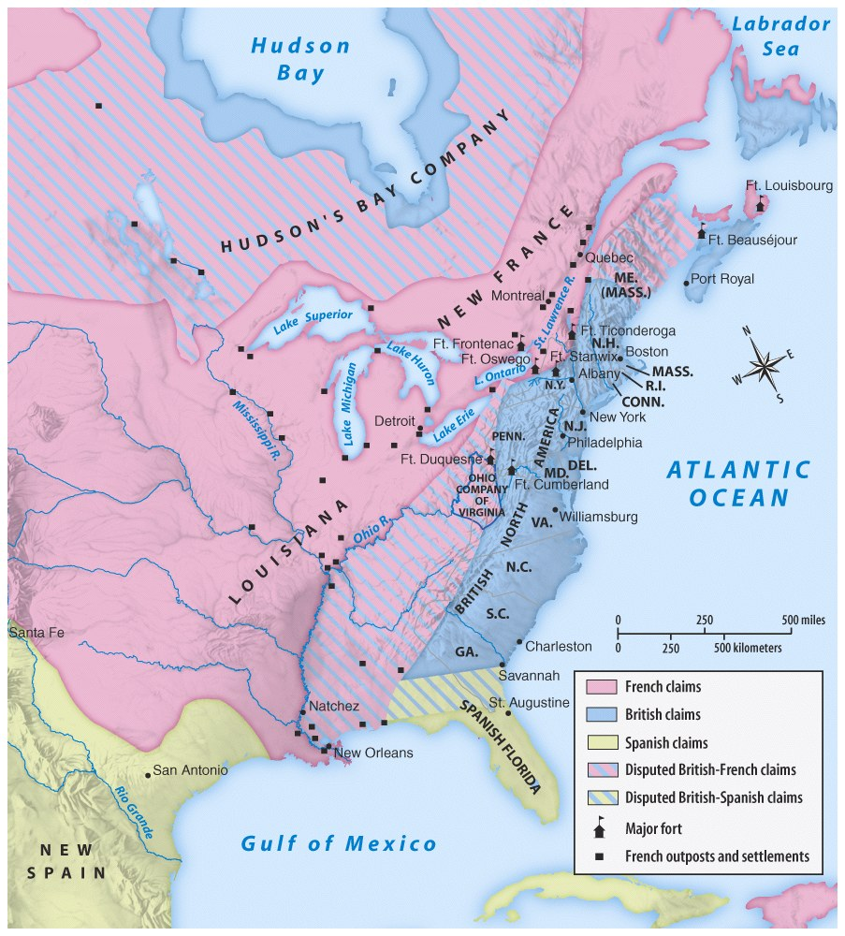
During the 1700s, both the British & French colonies were growing
Land disputes along the Ohio River Valley led to the French & Indian War

Slide 6
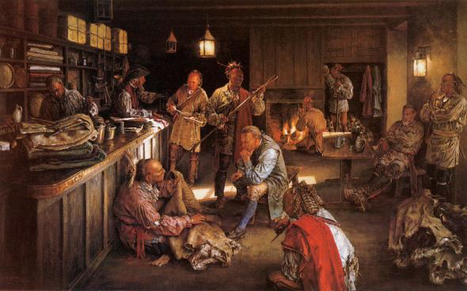
The growth of the British & French colonies impacted Indians too:
The French increased their alliances with Native Americans along the Ohio River Valley
The spread of British colonists into the backcountry & across the Appalachian Mountains led to numerous Indian conflicts

Slide 7
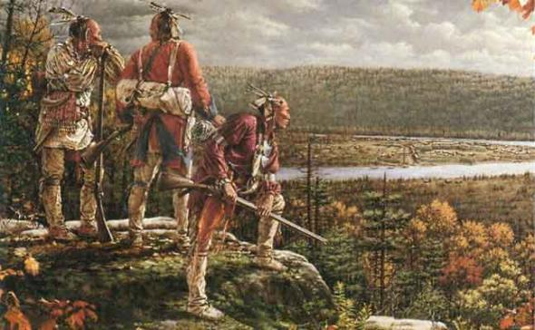
Indians grew increasingly concerned about British colonists filling into the backcountry
New settlement

Slide 8
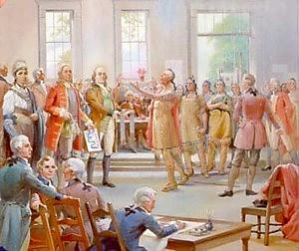
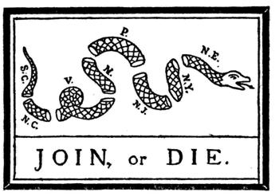
In 1754, colonists from across the British colonies met at the Albany Congress to discuss the common problem of Indian attacks
Benjamin Franklin proposed the Albany Plan of Union for a coordinated colonial army
The plan was not approved
The colonists lacked the unity to solve a common problem

Slide 9
Ben Franklin’s “Albany Plan of Union” America’s 1st political cartoon

Slide 10
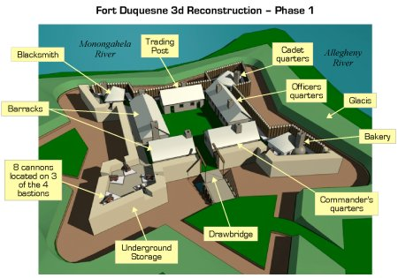
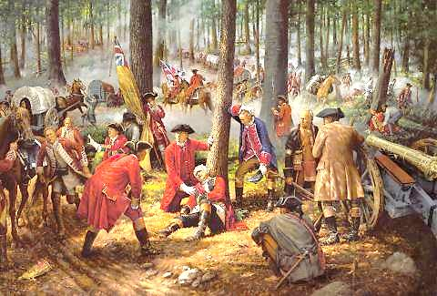
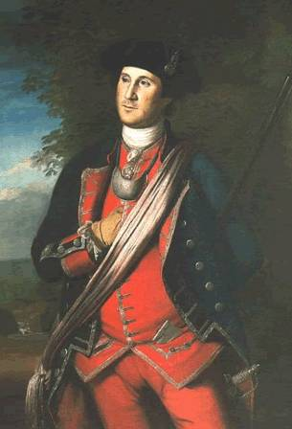
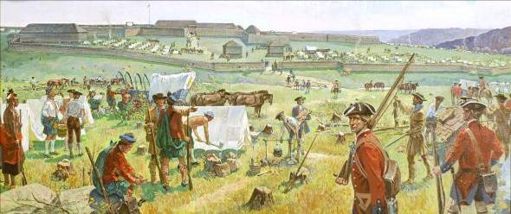
Turning Point: 1754
In 1754, VA governor sent 22 year old George Washington to protect an Ohio Company claim
Washington’s troops were forced to retreat from Fort Duquesne; This clash proved to be the beginning of the French & Indian War

Slide 11
The French and Indian War (1754-1763)
Britain & the North American colonists
France, their colonists, & Indian allies
vs

Slide 12
The war started in North America (1754-1763), but became part of a larger, “world” war called the Seven Years War (1756-1763) due to competition among empires

Slide 13
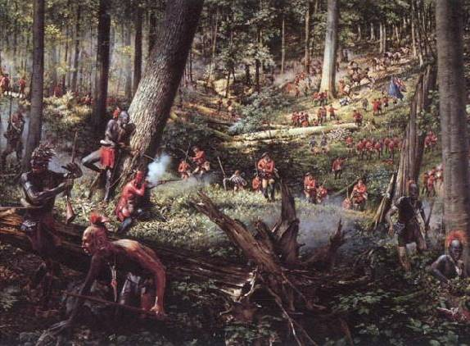
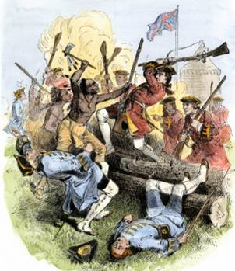
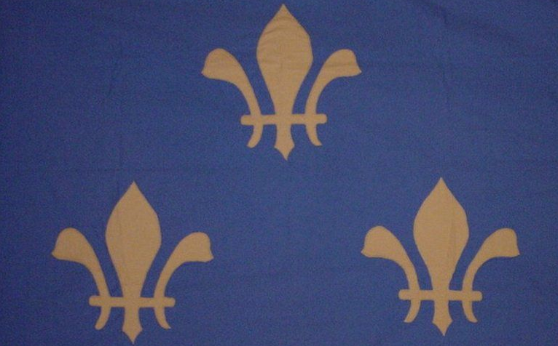
Battle Scene of the French and Indian War

Slide 14
The French and Indian War (1754-1763)
Britain was losing during the early years of the war
The colonists saw this war as another European conflict & did not help fight or raise taxes as much as England expected
But, in 1757, British Prime Minister William Pitt issued a “blank check” to win the war
Notes:
Pitt understood that winning this war meant the future of British mercantilism

Slide 15
The war officially ended with the Treaty of Paris in 1763
France lost Canada, most of its empire in India, & claims to lands east of the Mississippi River
Spain got all lands west of the Mississippi River, New Orleans, but lost Florida to England
England gained all French lands in Canada & exclusive rights to the Caribbean slave trade
North America 1754
North America 1763

Slide 16
Closure Activity
North America 1763
Use the map provided to identify the areas under Spanish, French, & British control after the French & Indian War (by 1763)

Slide 17
Key Review Questions
North America 1763
How did winning the French & Indian War set up Britain as the dominant economic power in the world?
What effect might this victory have on British mercantilism?
How might this war impact the British colonists? Indians?

Slide 18
Essential Question:
How did imperial competition between Britain & France lead to the French & Indian War?
CPUSH Agenda for Unit 2.2:
Clicker Questions
“French & Indian War” Notes
Today’s HW: 4.1
Unit 2 Test: Friday, August 31

Slide 19
Essential Question:
How was the end of the French & Indian War in 1763 a “turning point” in American history?
Warm-Up Question:
The French & Indian War was a “turning point” in American history.
What effect might this victory have on British mercantilism?
How might this war impact the British colonists? Indians?

Slide 20
How was 1763 a “turning point” in American history? Situational Role Play Activity

Slide 21
Situation #1
According to the Treaty of Paris in 1763 that ended the French & Indian War, the French have no more colonies in North America (except Haiti in the Caribbean)

Slide 22
Situation #2
After the end of the French & Indian War, Parliament decided to leave the British army in North America

Slide 23
Situation #3
The costs of winning the French & Indian War left the British Empire in severe debt that it now must pay off:
British national debt, 1755: £74.6 million British national debt, 1764: £129.6 million

Slide 24
North America 1763
The French & Indian War changed the relationship between Britain & the American colonists
Colonists were excited about the possibility of new land in the west now that the French were gone
Colonists learned new guerilla fighting tactics from the Indians

Slide 25
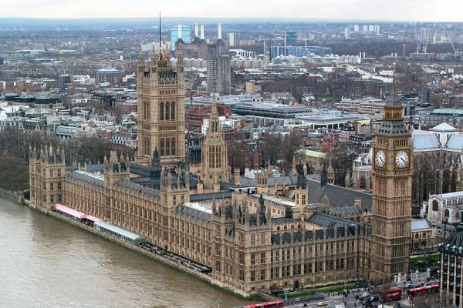
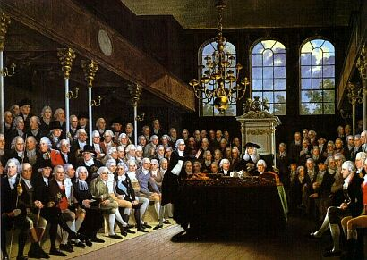
William Pitt’s “blank check” led to huge war debts
Parliament expected colonists to help pay off these debts
More decisions would now be made by British Parliament

Slide 26
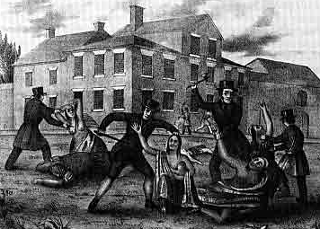
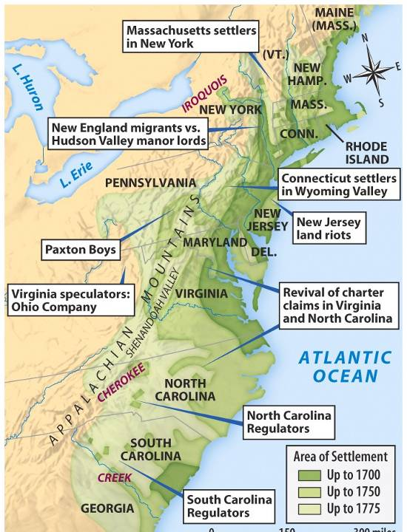
North America 1763
Other problems strained the relationship between Britain & the colonists after the war:
The expensive British army was not removed from America
The Ottawa Indians, led by Chief Pontiac, attacked frontier settlers who flooded into the Ohio Valley

Slide 27
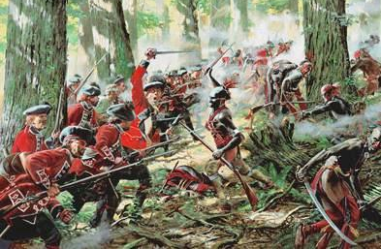
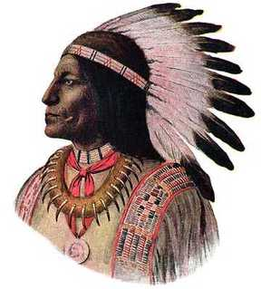
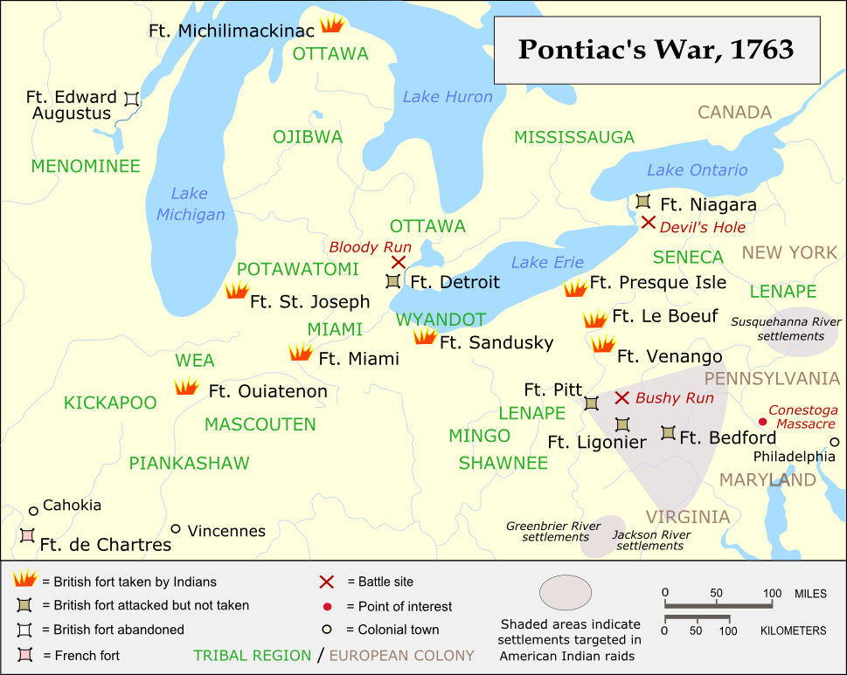
Pontiac’s Rebellion, 1763
Britain had to spend more money defending colonists in the frontier

Slide 28
Proclamation of 1763
After Pontiac’s Rebellion, the British Parliament created the Proclamation Line of 1763
Forbade colonists from moving across the Appalachian Mountains
Colonists were mad because this limited their ability to gain new land
Colonists were mad that this decision was made by Parliament & not in colonial assemblies

Slide 29
The French & Indian War brought an end to salutary neglect & began parliamentary sovereignty
English officials assumed that Parliament must have ultimate authority over ALL laws & taxes
“Parliament has the authority to rule”
The British began governing their colonies more strictly

Slide 30
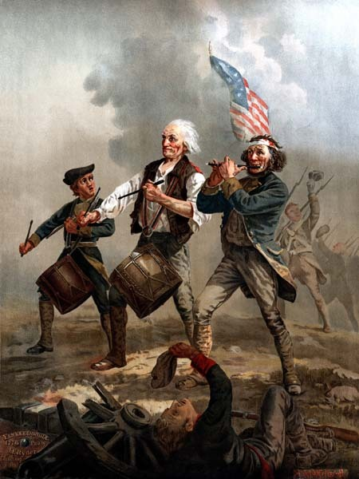
The end of salutary neglect
New taxes & laws were passed without asking colonial assemblies
As Britain assumed more control,
the colonists tried
to hang onto the power of their
colonial assemblies
This shift would prove to be the beginning of the long road towards colonial independence

Slide 31
Closure Activity
In groups, summarize the following:
As a result of the French & Indian War, how have things changed? Why was the war such a “turning point”?
From the British gov’t perspective, why are these changes necessary?
From the colonial perspective, why are these changes difficult to handle?

