Slide 1
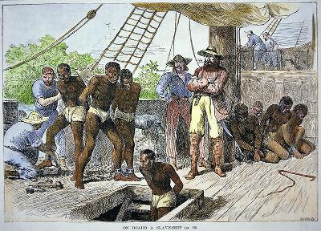
Social Studies Chapter 3 : Lesson 2 & 3
North American Settlements, Jamestown, and the Beginning of Slavery in The Americas
Textbook Pages: 59-62

Slide 2
I. England Begins to Colonize
A. After Exploration, England begins to colonize the areas they took over
B. England defeats Spain in 1588 clearing the way to colonize North American regions
C. England sends Sir Walter Raleigh to start a colony in North America
1. 1587 is granted a charter to take a voyage with a large group
2. Attempt to begin a civilization in Roanoke ( near present day North Carolina)
3. Raleigh goes back to England for supplies and returns 3 years later to find that everyone was gone.

Slide 3
II. Jamestown
A. England's 2nd attempt as establishing a colony to increase their wealth
B. joint stock companies were established to cover the cost of starting a settlement.
1. For example: 1606 King James I issued a chater to the Virginia Company in London to send settlers to the Atlantic Coast to make money from mining gold.
2. In May 1607 this group arrived along the James River in Virginia and named it Jamestown in honor of their king.
C. Life in Jamestown
1. 1st permanent settlement in N.America
2. Problems
a. Swampy, mosquito filled land
b. conflicts with Native Americans ( Algonquins) over territory
c. Selfishness and Greed of settlers, they didn't farm b/c they were looking for gold , therefore there was little food.
3. John Smith becomes the leader and persuades the Native Americans to help the settlers.
1. The settlement was saved and more people came to join them with more supplies in search of a new life in the Americas.
2. Many began to grow cash crops on plantation and needed cheap labor to help with the cost.

Slide 4
III. Slavery in the Americas
A. Colonial Slave Trade
1. Based on race as opposed to slavery in other parts of the world at this time where slaves could get out of slavery.
2. Colonial Slaves had little hope in freedom
3. One of the first groups to enslave African Americans was the Portuguese who purchased slaves from African rulers to work on sugar plantations.
B. The Slave Trade
1. Many times African Slaves were traded for needed supplies ( Guns, ammunition, textiles etc.)
2. Forced and Kidnapped from homes and sold ( Oludah Equiano)
3. Put on slave ships with no sanitation and often died of disease.
C. Indentured Servants
1. England had colonies in the Caribbean where they used for cheap labor
2. indentured servants agreed to work to pay off a debt and many times were given land after they worked off what they owed.
3. Rich land owners relied on slavery to support tobacco, rice, cotton, and indigo plantations.

Slide 5
Exit Questions: Complete on the paper provided to you
1.) Name 3 problems the people in Jamestown faced
2.) Why was the slave trade so important to settlers in the English Colonies?
Homework:
Read the Point of View Activity on page 63. Comnplete the 3 Document Based Questions in the homework section of your notebook.

